Slide 1

18CSC207J – Advanced Programming Practice
C.Arun, Asst. Prof. Dept of Software Engineering, School of Computing, SRMIST

Slide 2

Declarative Programming Paradigm

Slide 3
Declarative Programming Paradigm
Broadly speaking, computer programming languages have been divided into two categories---imperative languages and declarative languages.
Imperative programming lays more stress on "how" a solution procedure is specified.
Imperative: Programming with an explicit sequence of commands that update state.
Declarative Programming stress on “what to do” rather than “how to do”.
Declarative: Programming by specifying the result you want, not how to get it.
Declarative programming languages is that they always describe the desired end result rather than outlining all the intermediate work steps.
In declarative programming, the solution path to reach the goal is determined automatically.

Slide 4
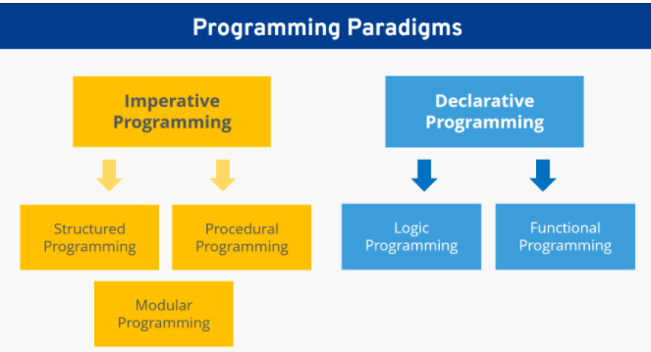
Declarative Programming Paradigm

Slide 5
Declarative vs Imperative
Imagine you walk into your favorite coffee place and you would like to order some coffee.
The imperative approach will be:
Enter the coffee shop
Queue in the line and wait for the barista asking you for your order
Order
Yes, for takeaway, please
Pay
Present your loyalty card to collect points
Take your order and walk away
Imagine you walk into your favorite coffee place and you would like to order some coffee.
The declarative approach:
A large latte for takeaway, please

Slide 6
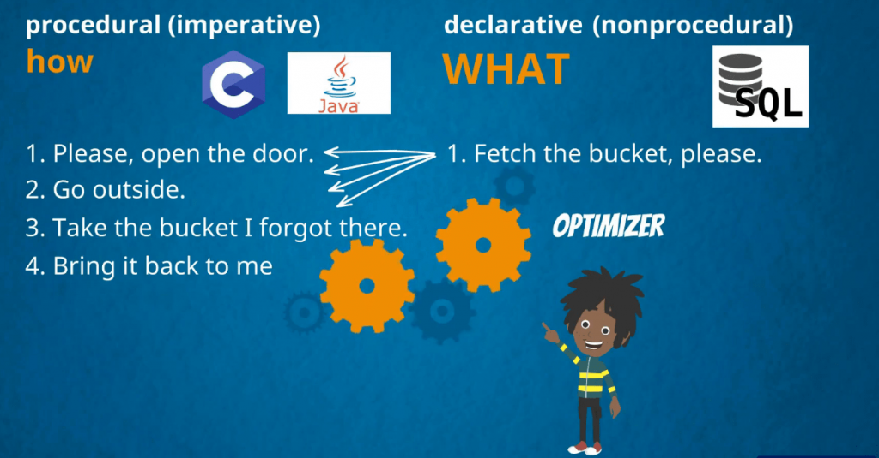
Declarative vs Imperative

Slide 7
Declarative vs Imperative
Sum of the elements of list
l1 =[12,76,34,96,45,62,71]
#imperative approach
Sum =0
for i in l1:
sum +=i
#declarative approach
Sum(l1)

Slide 8
Declarative Programming Paradigm - Language
SQLite3 - RDMS
Relational databases model data by storing rows and columns in tables. The power of the relational database lies in its ability to efficiently retrieve data from those tables and in particular where there are multiple tables and the relationships between those tables involved in the query.
Database - contains many tables
Relation (or table) - contains tuples and attributes
Tuple (or row) - a set of fields that generally represents an “object” like a person or a music track
Attribute (also column or field) - one of possibly many elements of data corresponding to the object represented by the row

Slide 9
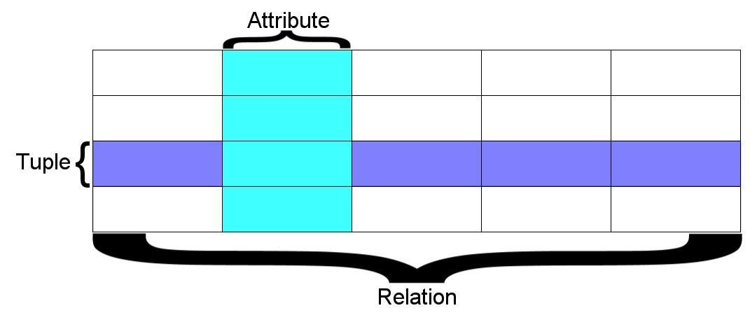
Declarative Programming Paradigm - Language
A relation is defined as a set of tuples that have the same attributes. A tuple usually represents an object and information about that object. Objects are typically physical objects or concepts. A relation is usually described as a table, which is organized into rows and columns. All the data referenced by an attribute are in the same domain and conform to the same constraints.

Slide 10
SQL
Structured Query Language is the language we use to issue commands to the database
Create a table
Retrieve some data
Insert data
Delete data

Slide 11
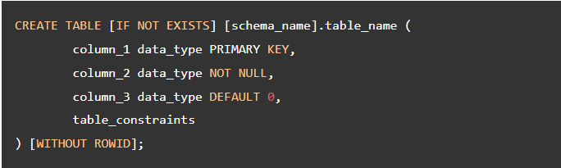

SQL – CURD Operations

Slide 12

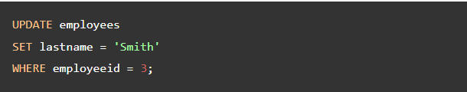

SQL – CURD Operations

Slide 13
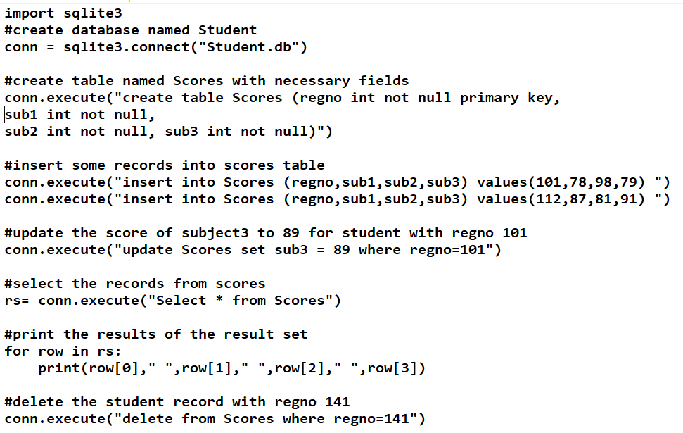
SQL – CURD Operations

Slide 14
IMPERATIVE
PROGRAMMING PARADIGM
Mrs. S. Niveditha
Assistant Professor (Sr. G) Department of Computer Science and Engineering
SRMIST, Vadapalani Campus

Slide 15
Topics
Program state, instructions to change the program state
Combining Algorithms and Data Structures
Imperative Vs Declarative Programming
Other Languages: PHP, Ruby, Perl, Swift
Demo: Imperative Programming in Python

Slide 16
INTRODUCTION
In a computer program, a variable stores the data. The contents of these locations at any givenpoint in the
program’s execution are called the program’s state.
Imperative programming is characterized by programming with state and commands which modify the state.
The first imperative programming languages were machinelanguages.

Slide 17
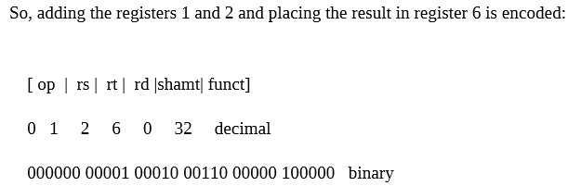
Machine Language
a very specific task, such
load, a jump, or
an ALU operation on a
Each instruction performs as a
unit
For
– rs,
of data in a
CPU register or memory.
example:
rt, and rd
indicate register operands shift amount
– shamt gives a
– the
address or operand
immediate fields contain an
directly

Slide 18
Assembly Code
10110000 01100001
Equivalent Assembly code
B0 61
– B0 - ‘Move a copy of the (AL is a register)
following
valueinto AL’
– 61 is a hexadecimal
representation of the
value01100001 – 97
Intel
MOV
assembly language
AL, 61h; Load AL with 97
decimal
(61 hex)

Slide 19
Other Languages
FORTRAN(FORmula
TRANslation) was
the first
It was
high level designed notation,
language to gain wide
scientific applications and
acceptance.
featured an algebraic
for
types,
subprograms, and
formatted
Business
input/output.
Oriented
COBOL (COmmon at
in for
ALGOL
in
Language) Department
was designed of Defence
need
the initiative of the U. 1959 and implemented in
S.
1960 to
meet the
business data processing
applications.
Language) committee
60 (ALGorithmic Oriented 1960 by an international
was designed
for use in
scientific problem solving

Slide 20
Evolutionary developments
PL / I to FORTRAN
Algol to PL /I
COBOL to PL/I
LISP to PL/I
Block structure
Control statements
Recursion
Subprograms
Formatted IO
File
manipulation
Record
Dynamic storage allocation
Linked structures

Slide 21
OVERVIEW
In imperative programming,
a name may be later reassigned to
assigned to a value and
another value.
The collection
of names
and the associated in the
values and the location of
control state.
program constitute the
The state is a logical
model of
storage locations
whichis an association between memory
and values.
A program
states.
in execution generates a sequence of
The transition from one state to the
next is
determined by assignment commands.
operations and sequencing

Slide 22
Highlights on
Assignment,
goto commands
structured programming
Command
Statement
Procedure
Control-flow
Imperative
language
Assertions
Axiomatic semantics
State
Variables
Instructions
Control structures

Slide 23
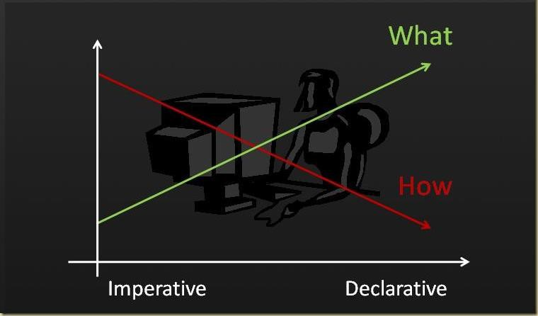
Declarative Vs Imperative

Slide 24


Declarative Vs Imperative
# Declarative
# Imperative

Slide 25
DEMO

Slide 26
An algorithm to add two numbers
entered by user
Step 1: Start
Step 2: Declare variables num1, num2 and sum. Step 3: Read values num1 and num2.
Step 4: Add num1 and num2 and assign the result to
sum. sum←num1+num2
Step 5: Display sum
Step 6: Stop

Slide 27
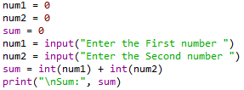

Addition two numbers entered by user

Slide 28
An Algorithm to Get n number, print the same and find Sum of n numbers
Step 1: Start
Step 2: Declare variable sum = 0.
Step 3: Get the value of limit “n”.
Step 4: If limit is reached, goto Step 7 else goto Step 5 Step 5: Get the number from user and add it to sum Step 6: Goto Step 4
Step 7: If limit is reached, goto Step 9 else goto Step 8 Step 8: Print the numbers
Step 9: Goto Step 7
Step 9: Display sum Step 10: Stop

Slide 29
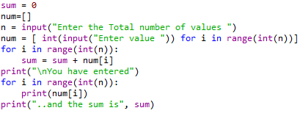
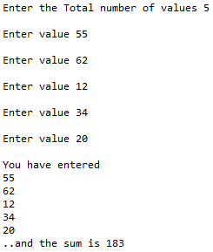

Slide 30



Slide 31
18CSC207J – Advanced Programming Practice
C.Arun, Asst. Prof. Dept of Software Engineering, School of Computing, SRMIST

Slide 32
GUI & Event Handling Programming Paradigm

Slide 33
Event Driven Programming Paradigm
Event-driven programming is a programming paradigm in which the flow of program execution is determined by events - for example a user action such as a mouse click, key press, or a message from the operating system or another program.
An event-driven application is designed to detect events as they occur, and then deal with them using an appropriate event-handling procedure.
In a typical modern event-driven program, there is no discernible flow of control. The main routine is an event-loop that waits for an event to occur, and then invokes the appropriate event-handling routine.
Event callback is a function that is invoked when something significant happens like when click event is performed by user or the result of database query is available.
Event Handlers: Event handlers is a type of function or method that run a specific action when a specific event is triggered. For example, it could be a button that when user click it, it will display a message, and it will close the message when user click the button again, this is an event handler.
Trigger Functions: Trigger functions in event-driven programming are a functions that decide what code to run when there are a specific event occurs, which are used to select which event handler to use for the event when there is specific event occurred.
Events: Events include mouse, keyboard and user interface, which events need to be triggered in the program in order to happen, that mean user have to interacts with an object in the program, for example, click a button by a mouse, use keyboard to select a button and etc.

Slide 34
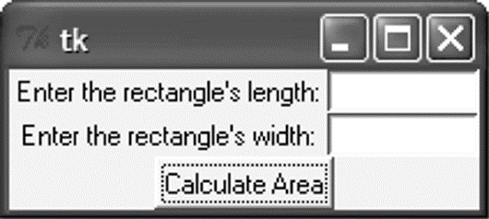
Introduction
A graphical user interface allows the user to interact with the operating system and other programs using graphical elements such as icons, buttons, and dialog boxes.
GUIs popularized the use of the mouse.
GUIs allow the user to point at graphical elements and click the mouse button to activate them.
GUI Programs Are Event-Driven
User determines the order in which things happen
GUI programs respond to the actions of the user, thus they are event driven.
The tkinter module is a wrapper around tk, which is a wrapper around tcl, which is what is used to create windows and graphical user interfaces.

Slide 35
Introduction
A major task that a GUI designer needs to do is to determine what will happen when a GUI is invoked
Every GUI component may generate different kinds of “events” when a user makes access to it using his mouse or keyboard
E.g. if a user moves his mouse on top of a button, an event of that button will be generated to the Windows system
E.g. if the user further clicks, then another event of that button will be generated (actually it is the click event)
For any event generated, the system will first check if there is an event handler, which defines the action for that event
For a GUI designer, he needs to develop the event handler to determine the action that he wants Windows to take for that event.
Any event?
Is there
an event handler
for that
event?
Yes
Yes
No
No
Run event
handler

Slide 36
GUI Using Python
Tkinter: Tkinter is the Python interface to the Tk GUI toolkit shipped with Python.
wxPython: This is an open-source Python interface for wxWindows
PyQt −This is also a Python interface for a popular cross-platform Qt GUI library.
JPython: JPython is a Python port for Java which gives Python scripts seamless access to Java class libraries on the local machine

Slide 37
Tkinter
Tkinter Programming:
Tkinter is the standard GUI library for Python. Python when combined with Tkinter provides a fast and easy way to create GUI applications. Tkinter provides a powerful object-oriented interface to the Tk GUI toolkit.
Creating a GUI application using Tkinter is an easy task. All you need to do is perform the following steps:
Example:
Import the Tkinter module.
Create the GUI application main window.
Add one or more of the above mentioned widgets to the GUI application.
Enter the main event loop to take action against each event triggered by the user.
import Tkinter
top = Tkinter.Tk()
# Code to add widgets will go here...
top.mainloop()

Slide 38
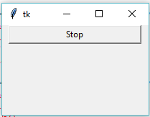
Tkinter Programming
Tkinter is the standard GUI library for Python.
Creating a GUI application using Tkinter
Steps
Import the Tkinter module.
Import tKinter as tk
Create the GUI application main window.
root = tk.Tk()
Add one or more of the above-mentioned widgets to the GUI application.
button = tk.Button(root, text='Stop', width=25, command=root.destroy)
button.pack()
Enter the main event loop to take action against each event triggered by the user.
root.mainloop()

Slide 39
Tkinter widgets
Tkinter provides various controls, such as buttons, labels and text boxes used in a GUI application. These controls are commonly called widgets.
Widget | Description
Label | Used to contain text or images
Button | Similar to a Label but provides additional functionality for mouse overs, presses, and releases as well as keyboard activity/events
Canvas | Provides ability to draw shapes (lines, ovals, polygons, rectangles); can contain images or bitmaps
Radiobutton | Set of buttons of which only one can be "pressed" (similar to HTML radio input)
Checkbutton | Set of boxes of which any number can be "checked" (similar to HTML checkbox input)
Entry | Single-line text field with which to collect keyboard input (similar to HTML text input)
Frame | Pure container for other widgets
Listbox | Presents user list of choices to pick from
Menu | Actual list of choices "hanging" from a Menubutton that the user can choose from
Menubutton | Provides infrastructure to contain menus (pulldown, cascading, etc.)
Message | Similar to a Label, but displays multi-line text
Scale | Linear "slider" widget providing an exact value at current setting; with defined starting and ending values
Text | Multi-line text field with which to collect (or display) text from user (similar to HTML TextArea)
Scrollbar | Provides scrolling functionality to supporting widgets, i.e., Text, Canvas, Listbox, and Entry
Toplevel | Similar to a Frame, but provides a separate window container

Slide 40
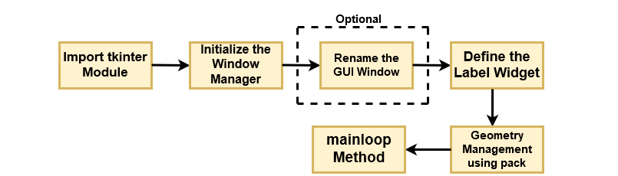
Operation Using Tkinter Widget

Slide 41
Geometry Managers
The pack() Method − This geometry manager organizes widgets in blocks before placing them in the parent widget.
widget.pack( pack_options )
options
expand − When set to true, widget expands to fill any space not otherwise used in widget's parent.
fill − Determines whether widget fills any extra space allocated to it by the packer, or keeps its own minimal dimensions: NONE (default), X (fill only horizontally), Y (fill only vertically), or BOTH (fill both horizontally and vertically).
side − Determines which side of the parent widget packs against: TOP (default), BOTTOM, LEFT, or RIGHT.
The grid() Method − This geometry manager organizes widgets in a table-like structure in the parent widget.
widget.grid( grid_options )
options −
Column/row − The column or row to put widget in; default 0 (leftmost column).
Columnspan, rowsapn− How many columns or rows to widgetoccupies; default 1.
ipadx, ipady − How many pixels to pad widget, horizontally and vertically, inside widget's borders.
padx, pady − How many pixels to pad widget, horizontally and vertically, outside v's borders.

Slide 42
Geometry Managers
The place() Method − This geometry manager organizes widgets by placing them in a specific position in the parent widget.
widget.place( place_options )
options −
anchor − The exact spot of widget other options refer to: may be N, E, S, W, NE, NW, SE, or SW, compass directions indicating the corners and sides of widget; default is NW (the upper left corner of widget)
bordermode − INSIDE (the default) to indicate that other options refer to the parent's inside (ignoring the parent's border); OUTSIDE otherwise.
height, width − Height and width in pixels.
relheight, relwidth − Height and width as a float between 0.0 and 1.0, as a fraction of the height and width of the parent widget.
relx, rely − Horizontal and vertical offset as a float between 0.0 and 1.0, as a fraction of the height and width of the parent widget.
x, y − Horizontal and vertical offset in pixels.

Slide 43
Common Widget Properties
Common attributes such as sizes, colors and fonts are specified.
Dimensions
Colors
Fonts
Anchors
Relief styles
Bitmaps
Cursors

Slide 44
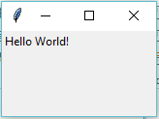
Label Widgets
A label is a widget that displays text or images, typically that the user will just view but not otherwise interact with. Labels are used for such things as identifying controls or other parts of the user interface, providing textual feedback or results, etc.
Syntax
tk.Label(parent,text=“message”)
Example:
import tkinter as tk
root = tk.Tk()
label = tk.Label(root, text='Hello World!')
label.grid()
root.mainloop()

Slide 45
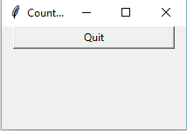
Button Widgets
import tkinter as tk
r = tk.Tk()
r.title('Counting Seconds')
button = tk.Button(r, text='Stop', width=25, command=r.destroy)
button.pack()
r.mainloop()

Slide 46
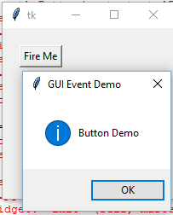
Button Widgets
A button, unlike a frame or label, is very much designed for the user to interact with, and in particular, press to perform some action. Like labels, they can display text or images, but also have a whole range of new options used to control their behavior.
Syntax
button = ttk.Button(parent, text=‘ClickMe', command=submitForm)
Example:
import tkinter as tk
from tkinter import messagebox
def hello():
msg = messagebox.showinfo( "GUI Event Demo","Button Demo")
root = tk.Tk()
root.geometry("200x200")
b = tk.Button(root, text='Fire Me',command=hello)
b.place(x=50,y=50)
root.mainloop()

Slide 47
Button Widgets
Button:To add a button in your application, this widget is used.
Syntax :
w=Button(master, text=“caption” option=value)
master is the parameter used to represent the parent window.
activebackground: to set the background color when button is under the cursor.
activeforeground: to set the foreground color when button is under the cursor.
bg: to set he normal background color.
command: to call a function.
font: to set the font on the button label.
image: to set the image on the button.
width: to set the width of the button.
height: to set the height of the button.

Slide 48
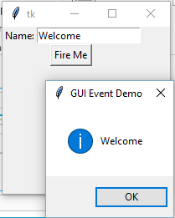
Entry Widgets
An entry presents the user with a single line text field that they can use to type in a string value. These can be just about anything: their name, a city, a password, social security number, and so on.
Syntax
name = ttk.Entry(parent, textvariable=username)
Example:
def hello():
msg = messagebox.showinfo( "GUI Event Demo",t.get())
root = tk.Tk()
root.geometry("200x200")
l1=tk.Label(root,text="Name:")
l1.grid(row=0)
t=tk.Entry(root)
t.grid(row=0,column=1)
b = tk.Button(root, text='Fire Me',command=hello)
b.grid(row=1,columnspan=2);
root.mainloop()

Slide 49
Canvas
The Canvas is a rectangular area intended for drawing pictures or other complex layouts. You can place graphics, text, widgets or frames on a Canvas.
It is used to draw pictures and other complex layout like graphics, text and widgets.
Syntax:
w = Canvas(master, option=value)
master is the parameter used to represent the parent window.
bd: to set the border width in pixels.
bg: to set the normal background color.
cursor: to set the cursor used in the canvas.
highlightcolor: to set the color shown in the focus highlight.
width: to set the width of the widget.
height: to set the height of the widget.

Slide 50
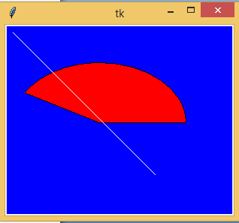

Canvas
from tkinter import *
master = Tk()
w = Canvas(master, width=40, height=60)
w.pack()
canvas_height=20
canvas_width=200
y = int(canvas_height / 2)
w.create_line(0, y, canvas_width, y )
mainloop()
from tkinter import *
from tkinter import messagebox
top = Tk()
C = Canvas(top, bg = "blue", height = 250, width = 300)
coord = 10, 50, 240, 210
arc = C.create_arc(coord, start = 0, extent = 150, fill = "red")
line = C.create_line(10,10,200,200,fill = 'white')
C.pack()
top.mainloop()

Slide 51
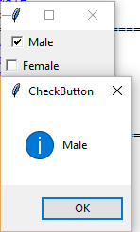
Checkbutton
A checkbutton is like a regular button, except that not only can the user press it, which will invoke a command callback, but it also holds a binary value of some kind (i.e. a toggle). Checkbuttons are used all the time when a user is asked to choose between, e.g. two different values for an option.
Syntax
w = CheckButton(master, option=value)
Example:
from tkinter import *
root= Tk()
root.title('Checkbutton Demo')
v1=IntVar()
v2=IntVar()
cb1=Checkbutton(root,text='Male', variable=v1,onvalue=1, offvalue=0, command=test)
cb1.grid(row=0)
cb2=Checkbutton(root,text='Female', variable=v2,onvalue=1, offvalue=0, command=test)
cb2.grid(row=1)
root.mainloop()
def test():
if(v1.get()==1 ):
v2.set(0)
print("Male")
if(v2.get()==1):
v1.set(0)
print("Female")

Slide 52
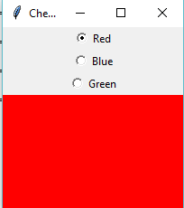
radiobutton
A radiobutton lets you choose between one of a number of mutually exclusive choices; unlike a checkbutton, it is not limited to just two choices. Radiobuttons are always used together in a set and are a good option when the number of choices is fairly small
Syntax
w = CheckButton(master, option=value)
Example:
root= Tk()
root.geometry("200x200")
radio=IntVar()
rb1=Radiobutton(root,text='Red', variable=radio,width=25,value=1, command=choice)
rb1.grid(row=0)
rb2=Radiobutton(root,text='Blue', variable=radio,width=25,value=2, command=choice)
rb2.grid(row=1)
rb3=Radiobutton(root,text='Green', variable=radio,width=25,value=3, command=choice)
rb3.grid(row=3)
root.mainloop()
def choice():
if(radio.get()==1):
root.configure(background='red')
elif(radio.get()==2):
root.configure(background='blue')
elif(radio.get()==3):
root.configure(background='green')

Slide 53
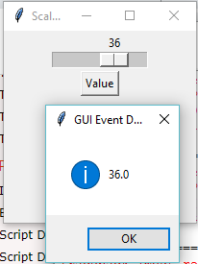
Scale
Scale widget is used to implement the graphical slider to the python application so that the user can slide through the range of values shown on the slider and select the one among them. We can control the minimum and maximum values along with the resolution of the scale. It provides an alternative to the Entry widget when the user is forced to select only one value from the given range of values.
Syntax
w = Scale(top, options)
Example:
from tkinter import messagebox
root= Tk()
root.title('Scale Demo')
root.geometry("200x200")
def slide():
msg = messagebox.showinfo( "GUI Event Demo",v.get())
v = DoubleVar()
scale = Scale( root, variable = v, from_ = 1, to = 50, orient = HORIZONTAL)
scale.pack(anchor=CENTER)
btn = Button(root, text="Value", command=slide)
btn.pack(anchor=CENTER)
root.mainloop()

Slide 54
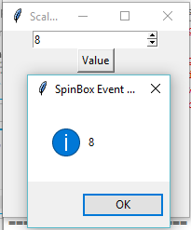
Spinbox
The Spinbox widget is an alternative to the Entry widget. It provides the range of values to the user, out of which, the user can select the one.
Syntax
w = Spinbox(top, options)
Example:
from tkinter import *
from tkinter import messagebox
root= Tk()
root.title('Scale Demo')
root.geometry("200x200")
def slide():
msg = messagebox.showinfo( "SpinBox Event Demo",spin.get())
spin = Spinbox(root, from_= 0, to = 25)
spin.pack(anchor=CENTER)
btn = Button(root, text="Value", command=slide)
btn.pack(anchor=CENTER)
root.mainloop()

Slide 55
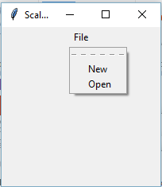
Menubutton
Menubutton widget can be defined as the drop-down menu that is shown to the user all the time. It is used to provide the user a option to select the appropriate choice exist within the application.
Syntax
w = Menubutton(Top, options)
Example:
from tkinter import *
from tkinter import messagebox
root= Tk()
root.title('Scale Demo')
root.geometry("200x200")
menubutton = Menubutton(root, text = "File", relief = FLAT)
menubutton.grid()
menubutton.menu = Menu(menubutton)
menubutton["menu"]=menubutton.menu
menubutton.menu.add_checkbutton(label = "New", variable=IntVar(),command=)
menubutton.menu.add_checkbutton(label = "Open", variable = IntVar())
menubutton.pack()
root.mainloop()

Slide 56
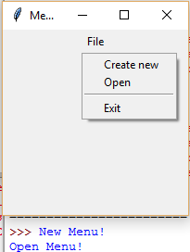
Menubutton
Menubutton widget can be defined as the drop-down menu that is shown to the user all the time. It is used to provide the user a option to select the appropriate choice exist within the application.
Syntax
w = Menubutton(Top, options)
Example:
from tkinter import *
from tkinter import messagebox
root= Tk()
root.title('Menu Demo')
root.geometry("200x200")
def new():
print("New Menu!")
def disp():
print("Open Menu!")
menubutton = Menubutton(root, text="File")
menubutton.grid()
menubutton.menu = Menu(menubutton, tearoff = 0)
menubutton["menu"] = menubutton.menu
menubutton.menu.add_command(label="Create new",command=new)
menubutton.menu.add_command(label="Open",command=disp)
menubutton.menu.add_separator()
menubutton.menu.add_command(label="Exit",command=root.quit)
menubutton.pack()

Slide 57
Imperative Programming Paradigm

Slide 58
Introduction
A program based on this paradigm is made up of a clearly-defined sequence of instructions to a computer.
Control flow in imperative programming is explicit: commands show how the computation takes place, step by step. Each step affects the global state of the computation.
Source code for imperative languages is a series of commands, which specify what the computer has to do – and when – in order to achieve a desired result. Values used in variables are changed at program runtime. To control the commands, control structures such as loops or branches are integrated into the code.
Closest to the actual mechanical behavior of a computer⇒ original imperative languages were abstractions of assembly language.
Imperative programs define sequences of commands/statements for the computer that change a program state (i.e., set of variables)
Commands are stored in memory and executed in the order found
Commands retrieve data, perform a computation, and assign the result to a memory location

Slide 59
Introduction
The imperative programming paradigm assumes that the computer can maintain through environments of variables any changes in a computation process. Computations are performed through a guided sequence of steps, in which these variables are referred to or changed. The order of the steps is crucial, because a given step will have different consequences depending on the current values of variables when the step is executed.
When a variable has state, something must maintain that state, which means that the variable is tied to a specific processor. Imperative coding works on simple applications, but code executes too slowly for optimal results on complex data science applications.
Owing to its comparatively slower and sequential execution strategy, it cannot be used for complex or parallel computations.

Slide 60
Introduction
Central elements of imperative paradigm:
Assignment statement: assigns values to memory locations and changes the current state of a program
Variables refer to memory locations
Step-by-step execution of commands
Control-flow statements: Conditional and unconditional (GO TO) branches and loops to change the flow of a program
First Imperative Languages : FOTRAN, ALGOL, COBOL

Slide 61
Introduction
Imperative programming languages are very specific, and operation is system-oriented. On the one hand, the code is easy to understand; on the other hand, many lines of source text are required to describe what can be achieved with a fraction of the commands using declarative programming languages.
The different imperative programming languages can, in turn, be assigned to three further subordinate programming styles – structured, procedural, and modular.
The structured programming style extends the basic imperative principle with specific control structures: sequences, selection, and iteration.
The procedural approach divides the task a program is supposed to perform into smaller sub-tasks, which are individually described in the code.
The modular programming model goes one step further by designing, developing, and testing the individual program components independently of one another.
Imperative programming languages are characterized by their instructive nature and, thus, require significantly more lines of code to express what can be described with just a few instructions in the declarative style.

Slide 62
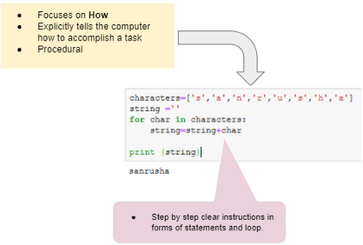
Imperative Programming Paradigm
Imperative programming provides explicit steps to the computer using statements, loops, etc.
Imperative Program
Focus on How
Explicitly tells the computer how to accomplish a task
Procedural
In a computer program, a variable stores the data. The contents of these locations at any given point in the program’s execution are called the program’s state.
Imperative programming is characterized by programming with state and commands which modify the state.
The first imperative programming languages were machine languages.
In imperative programming set of commands can be grouped in a code block also called Procedure.

Slide 63
Example
Example:
sample_characters = ['p','y','t','h','o','n'] sample_string = '' sample_string for c in sample_characters: sample_string = sample_string + c print(sample_string)
characters=['s','a','n','r','u','s','h','a']
string =''
for char in characters:
string=string+char
print (string)
import functools
characters=['s','a','n','r','u','s','h','a']
string=functools.reduce(lambda s,c:s+c,characters)
def stringc(characters):
string =''
for char in characters:
string=string+char
return string

Slide 64
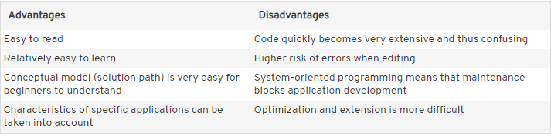
Imperative

Slide 65
Declarative Programming Paradigm

Slide 66
Introduction
General programming paradigm in which programs express the logic of a computation without describing its control flow.
Programs describe what the computation should accomplish, rather than how it should accomplish it.
Typically avoids the notion of variable holding state, and function side-effects.
Contrary to imperative programming, where a program is a series of steps and state changes describing how the computation is achieved.
Includes diverse languages/subparadigms such as:
Database query languages (e.g. SQL, Xquery)
XSLT
Makefiles
Constraint programming
Logic programming
Functional programming

Slide 67
Introduction
“Pure” declarative languages:
SQL (Structured Query Language – language to interact with databases):
SELECT * FROM Customers WHERE Country='Mexico';
Markup languages, like HTML, CSS (Cascading Style Sheets – language to describe styling of e.g. HTML pages), …
<h1 style="color:blue;">This is a Blue Heading</h1>
Functional programming languages like Haskell (even though they allow some “encapsulated” imperative parts)

